Slide 1
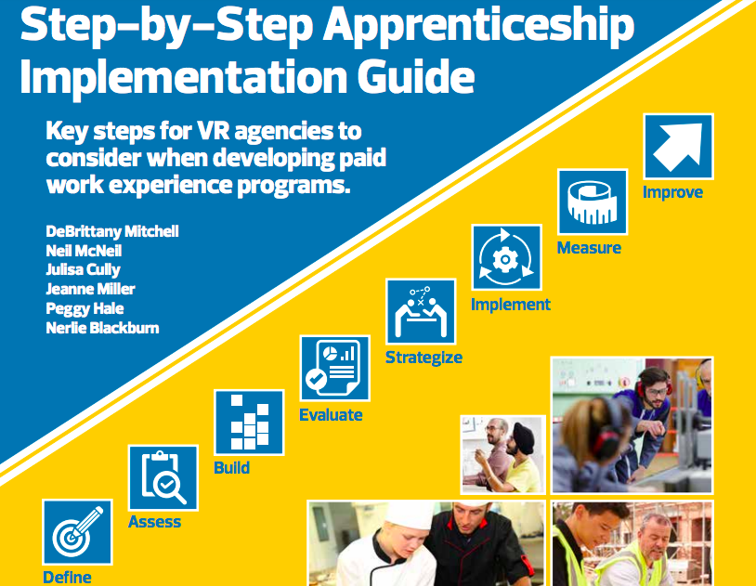
Step-by-Step Apprenticeship Guide
Notes:
Why we created the guide
The steps in the guide
Tips for using the guide
Where to find the guide
Self-Assessment exercise

Slide 2
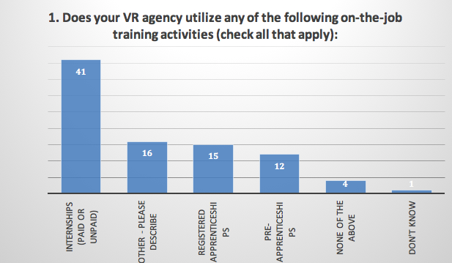

Slide 3
We asked… We listened!
Brief learning resources in clear, plain language
Opportunities to connect with and learn from examples of other states
Focus on strategies that VR can use
Step-by-step implementation instructions
The Paid Work Experiences Toolkit: https://www.explorevr.org/toolkits/customized-training-toolkit/workbased-learning/paid-work-experiences-toolkit

Slide 4
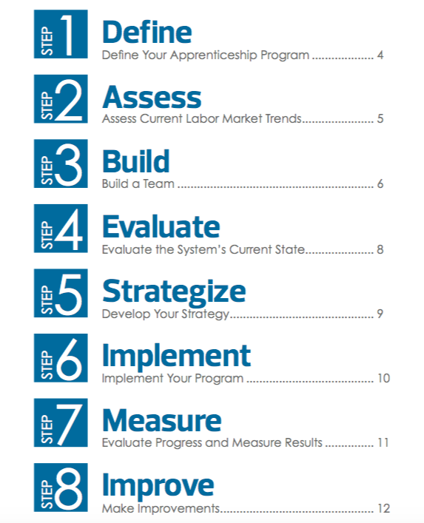
Notes:
Steps are not novel, but they are all necessary

Slide 5

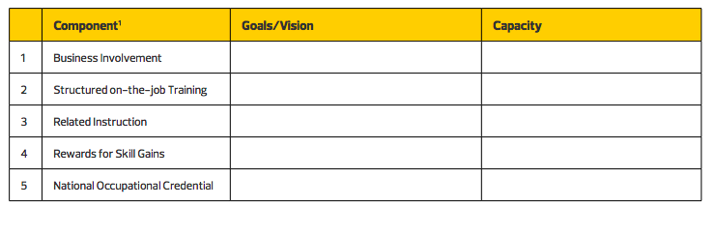
What are the standards set by your state’s office of apprenticeship training?
Consider your organizational capacity, resources, and strategic plan.
Notes:
Tom Hooper

Slide 6
Presidential Executive Order Expanding Apprenticeships in America
For purposes of this order:
(a) the term “apprenticeship” means an arrangement that includes a paid-work component and an educational or instructional component, wherein an individual obtains workplace-relevant knowledge and skills

Slide 7
State Examples
WASHINGTON
GEORGIA
Apprenticeship is a combination of on-the-job training (OJT) and related classroom instruction under the supervision of a journey-level craft person or trade professional in which workers learn the practical and theoretical aspects of a highly skilled occupation.
Apprenticeship is a work-based training method that combines formal instruction with on-site, occupation-related training.
Notes:
Tom Hooper

Slide 8

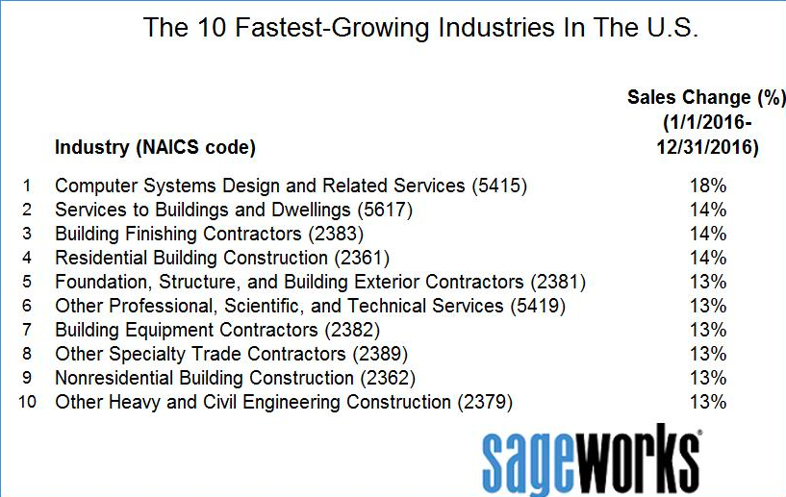
What are some growing, in-demand sectors as identified by LMI at the local, state, or national level?
Notes:
David Hoff

Slide 9

SOURCE: AJC

Slide 10

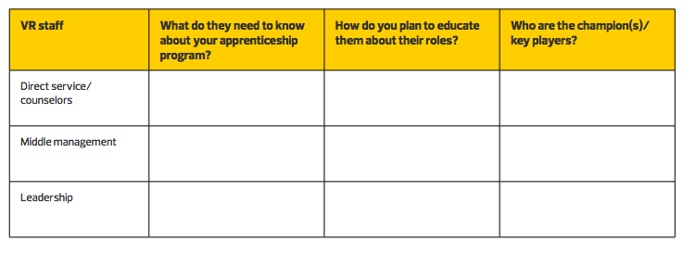
External Partners
Internal Partners
Establishing teams and roles
Notes:
Julisa Cully

Slide 11

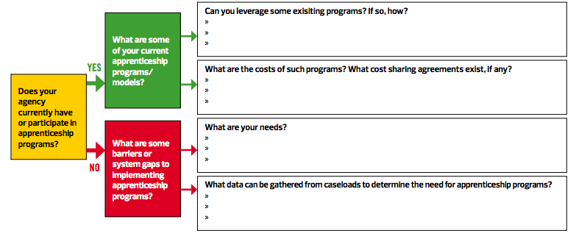
Notes:
Jeanne Miller

Slide 12

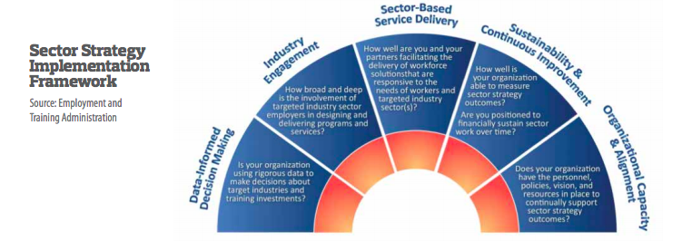
Notes:
Spend less time on the barriers and more time on how to address.. PEGGY HALE

Slide 13

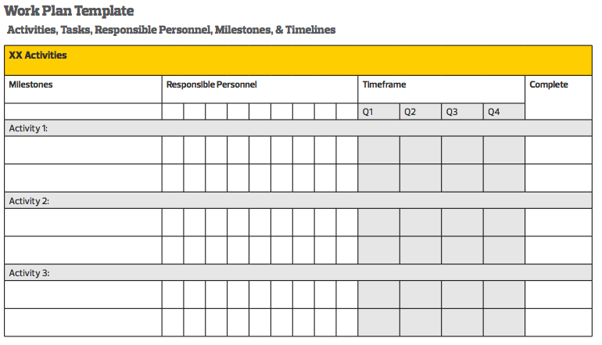
Notes:
HUGH BRADSHAW

Slide 14

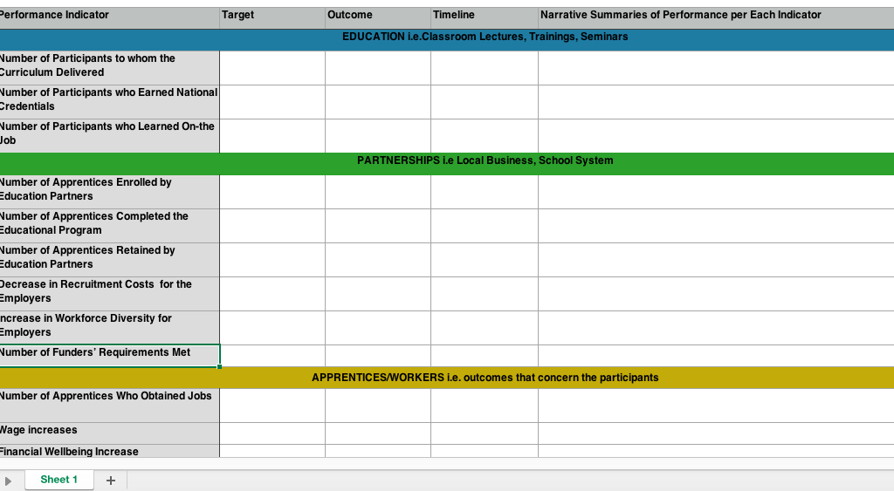
Notes:
ME

Slide 15

Make continuous improvements based on the feedback and outcomes you receive
There are many benefits to registering your program according to national standards for registration with the U.S. Department of Labor (or an approved State Apprenticeship Agency).
Notes:
NO FACILTATOR

Slide 16
Let’s get started!
Notes:
Facilitation is not meant

